Slide 1



Dutch Flag Algorithm
The Dutch Flag Algorithm is a partitioning algorithm used to sort an array with three distinct values. It's named after the Dutch flag, which has three horizontal stripes in red, white, and blue.
by Ahmed Osama

Slide 2

Overview of the Dutch Flag Algorithm
1
Partitioning the array
2
Rearranging the elements
The algorithm divides the array into three sections based on a chosen pivot element.
It rearranges the elements in such a way that the smaller elements come first, then the equal elements, and finally the larger elements.
3
Ensuring order
The algorithm ensures that the order of the smaller, equal, and larger elements is maintained.

Slide 3
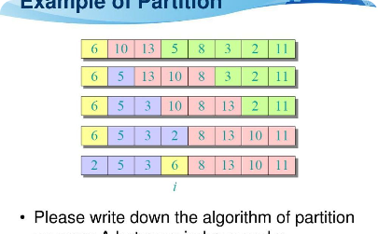

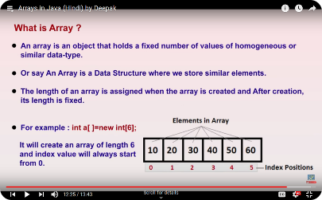
Partitioning the Array
Choosing a Pivot Element
Rearranging the Elements
Dividing the Array into Three Sections
The pivot element is selected from the array to divide it into three sections.
The elements are then rearranged based on their relation to the pivot element.
The array is divided into a section for smaller elements, a section for equal elements, and a section for larger elements.

Slide 4
Ensuring Order of Elements
1
Step 1
Initialize three pointers at the start of each section: smaller, equal, and larger.
Step 2
2
Increment the equal pointer and compare the element at that position with the pivot element.
3
Step 3
If the element is smaller, swap it with the element at the smaller pointer position and increment both pointers.
Step 4
4
If the element is larger, swap it with the element at the larger pointer position and decrement the larger pointer.

Slide 5
Performance Considerations and Complexity Analysis
Time Complexity
Space Complexity
The time complexity of the Dutch National Flag Algorithm is O(n), where n is the size of the input array. This is because the algorithm performs a single pass through the array, examining each element once. The number of operations grows linearly with the size of the input, making it highly efficient for large arrays.
The algorithm uses constant space O(1), as it only requires a few variables to store indices and swap elements.

Slide 6
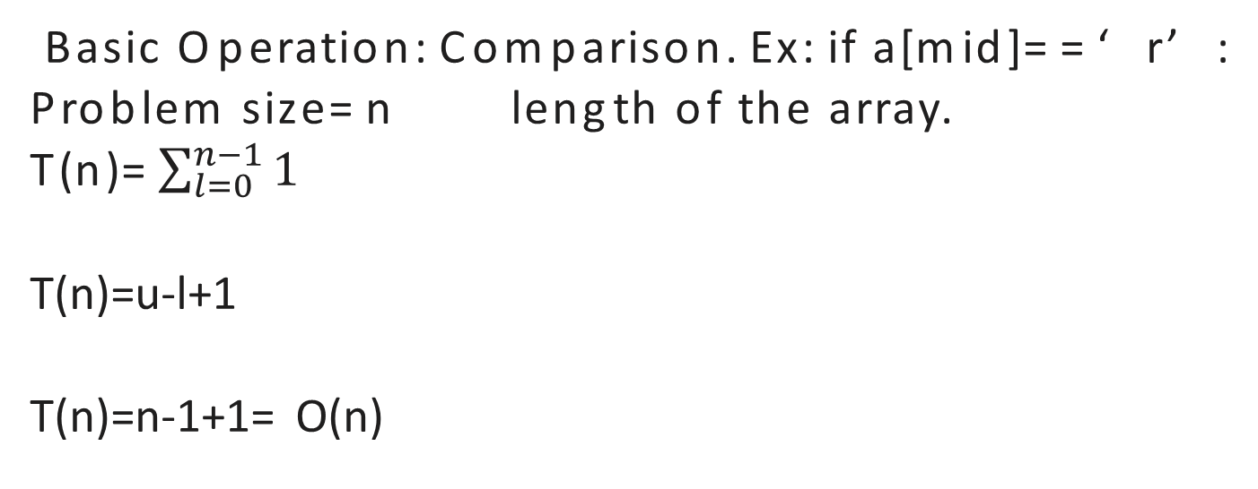
Time Complexity:
Basic Operation: Comparison. Ex: if a[mid]==‘r’:
Problem size=n length of the array.
T(n)=$\sum_{l=0}^{n−1}{1}$
T(n)=u-l+1
T(n)=n-1+1= O(n)

Slide 7

Conclusion
Efficient Sorting Algorithm 🚀
The Dutch Flag Algorithm is a simple and efficient solution for sorting arrays with three distinct values.

